Slide 1
Software Metrics Data Collection

Slide 2
Introduction
Software measurement is only as good as the data that are collected an analyze , we cannot make good decision with bad data.
What constitutes good data , and we present guidelines and examples to show how data collection support Decision making.

Slide 3
Software metrics data collection
What is good data
Corectness: Are they correct?
Accuracy: Are they accurate?
Precision: Are they appropriately precise?
Consistent: Are they consistent?
Timed: Are they associated with a particular activity or time period?
Repeatable: Can they be replicated?

Slide 4
What is Good Data?
Are they correct?
  Data collected according to the exact rules of definition of the metric.
  Eg-LOC supposed to include everything.
Are they accurate?
  It refers to the difference between the data and actual value.
  Eg- analog clock is less accurate than digital clock
Are they appropriately precise?
  Precision deal with number of decimal places needed to express the data.
  For instance activity duration need not be reported in hours, minutes, and seconds .Rather hours or days in sufficient.

Slide 5
Cont….
Are they consistent?
  Data should be consistent from measuring device or person to another , without large difference in value
  Eg:-measure the growth in size of product over time especially during maintenance.
Are they associated with a particular activity or time period?
  We know when and where they were collected , this association of values allows us to track trends and compare.
Can they be replicated?
  Measurement procedure described clearly enough for someone else to be able to replicate the measurement.
  Data support surveys,case study,experiment
  Project Result are stored in historical database

Slide 6
5.2.How to Define the Data
Two kinds of data
  Raw data
    Initial measurement of process , product or resource.
    Eg-weekly timesheet for each staff member working on a project.
  Refined data
    Extracting essential data from raw data.
    So that analysts can derive values about attributes.
  Direct measure
    Select all relevant timesheets and add up the figures.
    This refined data is still direct measure.
  Indirect Measurement
    Average effort per staff member , effort per design component.

Slide 7
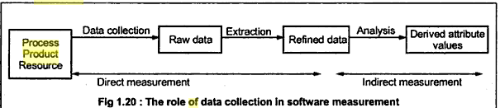

Slide 8
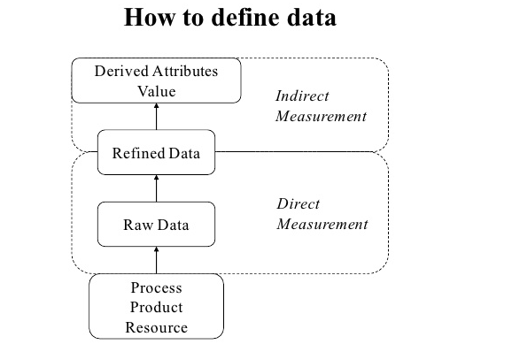

Slide 9
Indirect measure may be derived from direct measure.
Many organization are different, not only terms of business goal but also corporate culture, development preference , staff skills etc.
GQM Is preferable to adopting a “one-size-fits-all” standard measurement set.
Most organization have similar problems. interested in software quality , cost and schedule.

Slide 10
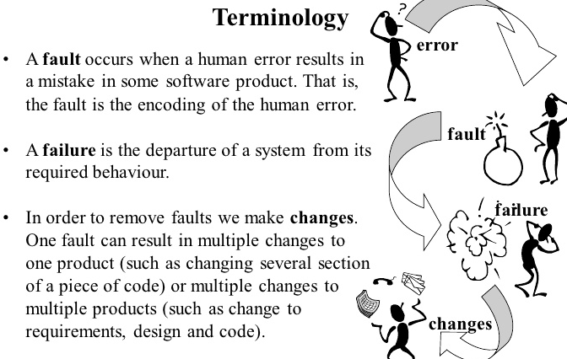

Slide 11
Terminology of Fault Tolerance
Error
Fault
Failure
causes
results in
Fault – is a defect within the system
Failure occurs when the system can no longer perform as required (does not meet spec)
Fault Tolerance – is ability of system to provide a service, even in the presence of errors

Slide 12
Software errors, software faults
and software failures
Software development process
software error
software fault
software failure

Slide 13
5.2.1 The Problem with Problems
To make quality product it is necessary to find the problems incurred earlier and prevent these problem(faults and error) later
1.Error
  Human action that produces an incorrect steps, process , result or data definition.
  Error is a mistake made by the developer . It might typographical error , misleading of specifications, a misunderstanding of subroutine.

Slide 14
Cont…
Error may be
  Actual bug in the code.
  Incorrect implementation of the requirement.
  Calculation error
  Errors in handling
  Documentation
  Testing errors
  UI Error:
    Functionality
    Communication
    Command structure
    Missing structure
    Performance
    Output.

Slide 15
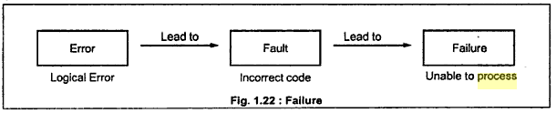
2.Failures
Fault(bug) can be undetected until a failure occurs, which is when user or tester perceives that the system is not delivered the expected service.
Failure can be discovered both before and after delivery.
Faults represents problem that the developers sees. Failure are the problems that the user sees.
Its defined as
  Deviation of the system from its expected behaviour or service.
  Inability of a system or component to perform its required functions within the specified performance requirement.

Slide 16
Categories
Maintenance problem in terms of failure,faults,changes
  Location: when the problem occur?
  Timing: when did it occur?
  Symptoms :What was observed?
  End result : Which consequence resulted?
  Mechanism: How did it occur?
  Cause: Why did it occur?
  Severity: how much was the user affected?
  Costs: How much did it cost?

Slide 17
Cont…
1.Location-installation and platform on which failure is observed.
  Eg-s/w is distributed ,then the terminal at which failure is observed must be identified.
2.Timing
  1.clock time
  2.Execution time up to the occurrence of failure of CPU time.

Slide 18
Cont…
3.Symptoms
  Error message or indication of failure
  IEEE Standard classification symptoms are:
    OS crash
    Program hang up
    Program crash
    Input problem:
      Corect input but not accepted
      Description incorrect or missing
      Parameter incomplete or missing
    Output problem
      Wrong format
      Incorrect result

Slide 19
Cont…
4.End Result:
  It refers to consequences of failure
    Service degraded
    Loss of data
    Wrong or no output
    OS crash
5.Mechanism
    It describes how the failure come about.
    Eg:-illegal keyboard command

Slide 20
Cont…
6.Cause
  It reference to fault leading failure.
Two aspects:
  1.Type of trigger(failure)
  2.Type of source
1.Trigger:
  Physical hardware failure
  Operating condition
  Erroneous report
2.Actual Source:
  Physical hardware fault
  Usability problem
  Coding fault

Slide 21
Cont…
7.Severity:
  It describe how series the failure was.
  It refers to well-defined scale such as “critical", "Minor” and “Major”.
8.Cost:
  Cost to system provider is recorded in terms of how much effort an other resources needed to diagnose and respond to failure.
  Cost=cost to fix +cost to loss

Slide 22
3.Faults
When a human error results in a mistake in some software products.
  Eg-Developer misunderstand a user-interface requirement and create a design with misunderstanding.
  Fault is the difference between incorrect program and correct version
  A single error can result in one or more faults.
  On faults can results in multiple changes to one product(changing several section of a piece of code).

Slide 23
Cont…
Location:
  High level classification can be used to report on location
  Spcification,code,database,manuals,procedures,reports,standards.
Timing relates to 3 events
  When the faults is created
  When the faults is detected
  When the faults is corrected.
Symptom
  It observed during diagonsis or inspection.

Slide 24
Cont…
End Result:
  Actual failure caused by the faults
Mechanism:
  It describes how the fault was
    Created
      Type of activity carried out when the faults was created.
    Detected
      It means by which the faults was found.
    Corrected.
      Refers to the steps taken to remove the fault or prevent the fault from causing failure

Slide 25
Cont…
Cause
  Human error that leads to fault
  Classification
  Communication-imperfect transfer of information
  Conceptual-misunderstanding
  Clerical-typographical or editing error
Severity-impact of the fault on the user
Cost-total cost of the fault to system provider.
Count-it include several counts , depending on the purpose of the field

Slide 26
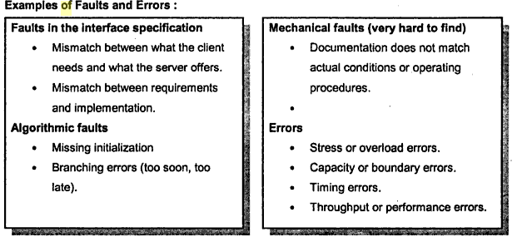
Faults and Error

Slide 27
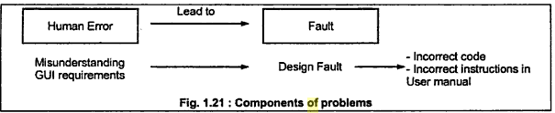
Cont…

Slide 28
4.Changes
Once a failure is experienced and its cause determined , the problem is fixed through one or more changes.
Changes includes to all or some development products.
1.Location
  Product , subsystem, component, module, subroutine affected by given change.
2.Timing
    When the change was made
3.End result
  Describe whether the change was successful or not.

Slide 29
Reason for changes
Corrective
  Correcting a faults discovered in software products
Adaptive
  System change in some way and a given product must be adopted to preserve functionality an performance.(Modify or enhance new features)
Preventive
  Developer discover faults by combining the code to find faults before they become failure.
Perfective
  Rewriting the documentation or comments or renaming a variable or routine(implement new or change user requirement, improve efficiency, reliability).

Slide 30
Cont…
5.Cause
  Change report is used to capture one of these reasons for change: corrective ,adaptive , preventive or perfective.
6. Cost
  Cost to the system developer of implementing a change.
7. Count
  Used to capture the number of changes made in a given time interval

Slide 31
5.3 How to Collect Data
It requires human observation and reporting.
Manual data recorded by Manager , programmer, tester and user must record the raw data on forms.
Automatic data capture is always desirable and essential
Many times its not possible to capture the data automatically . In such cases following procedures to be followed:
  Keep procedures simple
  Avoid unnecessary recording
  Proper training should be provided to staff to record the data.
  Result of data capture and analysis should be provided be promptly to the required person
  Validation of all Collected data should be done at central collection point

Slide 32
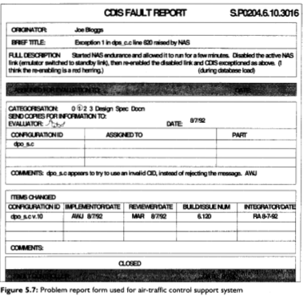

Slide 33
Planning for data collection involves 3 steps
1.Based on your GQM analysis , decide which products to measure:
2.Make sure the product is under configuration control
3.Establish the procedure for handling the forms, analyzing the data and reporting the results

Slide 34
Cont…
1.Based on your GQM analysis , decide which products to measure:
  The product measured individually or measured in a group.
  Measurement management and fault identification should be done at higher levels rather than waiting for the problem to occur at lower levels.

Slide 35
Cont…
2.Make sure the product is under configuration control
  GQM analysis suggest which attribute and measure should be evaluated.
  Made clear how the product versions, installation, failure, faults, etc, will be denoted on the data collections forms.

Slide 36
3.Establish procedures for handling the forms , analyzing the data and reporting the results.
  Properly defined that who is responsible for the data collection.

Slide 37
5.3.1 Data Collection Forms
Useful and good data is collected using data collection forms.
The forms should be self explanatory and include the data required for analysis and feedback.

Slide 38
5.4.When to Collect Data
It begins when project planning only.
Actual data collection takes place many phases of development.
Data relating to project personnel can be collected at the beginning of the project while other data collection such as effort begins at project starts and continues through operation and maintenance.

Slide 39
Data collection should be part of the regular development process.
It collected at beginning to establish the initial values , and then initial values are changed to reflect activities and resources.
4 important key sub processes
  1. Domain evolution
  2. Producing components
  3. Consuming components
  4. Library management

Slide 40
Reuse process model
Domain evolution involves identifying domains that are likely to provide reusable components.
Producer: Identify the reusable requirements and submit the component to library
Library management: evaluate or certify components and analyze library and component usage.
Consumer:-requirement analysis and build or change software.

Slide 41
5.5 How to Store and Extract Data
Stored on a database. DBMS has advantage over both paper records and computer stored “flat” files.
Format, ranges , valid values etc can be checked automatically as they are input.
To omit raw and unnecessary data , good general data structures and collection procedures should be defined and modified.

Slide 42
5.5.1 Raw database structure
It support system reliability based on reported failure data.
Each box is a table in the database, and an arrow denotes a many to one relationship from one table to another.
Double arrow indicates that at least one entity in the source table that maps to every entity in the target.

Slide 43
The Block of the Database
Product: Table of product being measured
Product Version: Table of all baseline product version
Installation- List of all installations on which these product version are run
Product Version Installation:- Records the availability of a baseline version of product on a installation
Period-Starts and end time during a product is measured.
Fault-Records each fault detected in one or more versions of products.
Fault Product Version-Table of fault-identifier pairs
Incident-Table of all failure recorded while using a version of a product on a given installation.

Slide 44
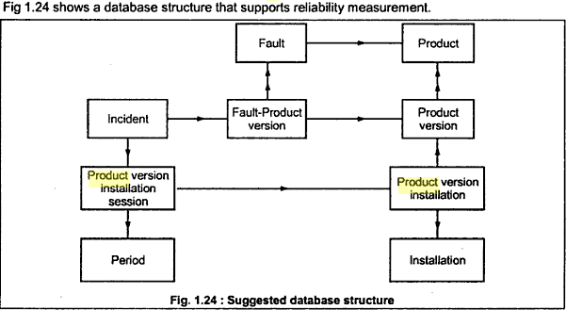

Slide 45
5.5.2. Extracting Data
Measurement are recorded properly and can be used for various kinds of analysis.
Eg: reliability data and generate measure of reliability for single baseline version.
Steps are
  Select every incident and cross reference the product version
  Group the resulting incidents records by the faults to which refer and sort each group by time of occurrence.
  Remove all but the first incident in each group.
  Count the remaining incidents within each period.
  Sum the use recorded in product version installation session for all the session within each periods.

